Slide 1
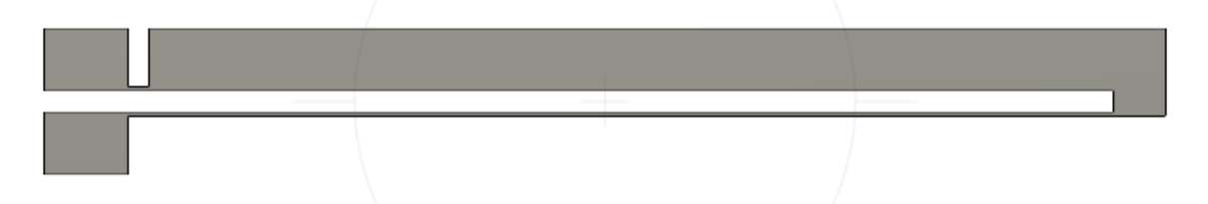
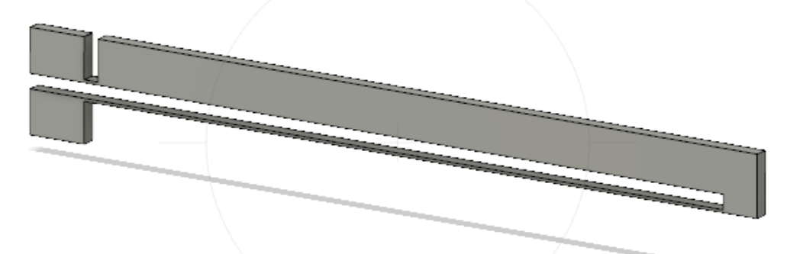
Design 1: One-hot-arm thermal actuator

Slide 2
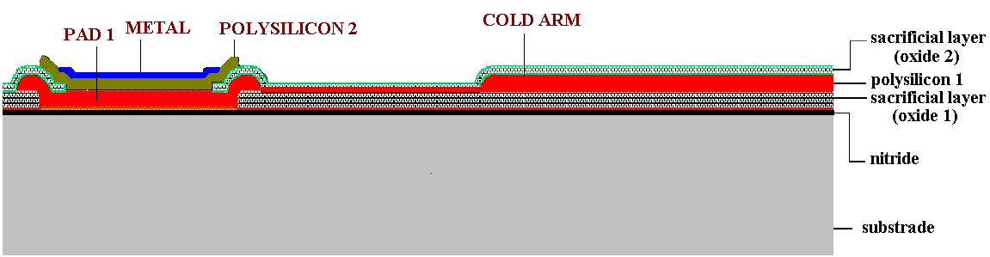
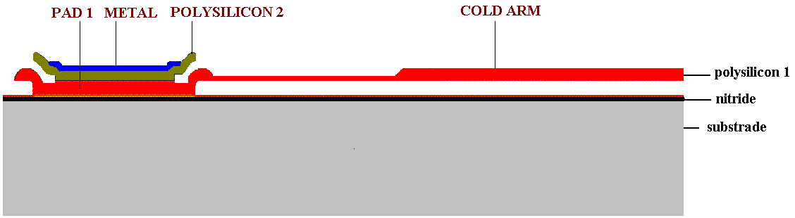
Fabrication of U-shaped Microactuator

Slide 3
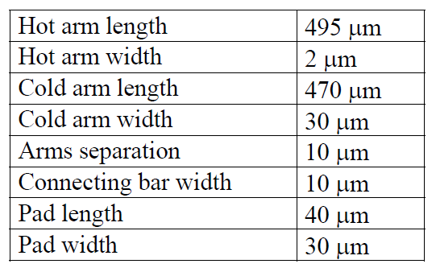
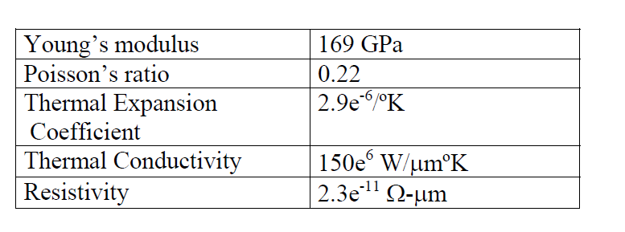
Parameter 1: One-hot-arm thermal actuator

Slide 4
Simulation 1: One-hot-arm thermal actuator

Slide 5
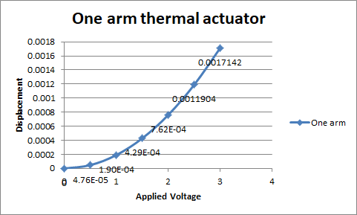
Results 1: One-hot-arm thermal actuator

Slide 6
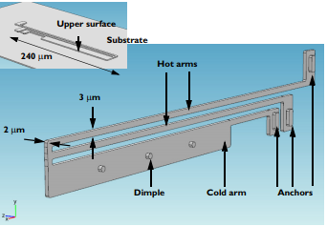
Design 2: Two-hot-arm thermal actuator
The temperature increase required to deform the two hot arms, and thus displace the actuator, is obtained through Joule heating (resistive heating)
The greater expansion of the hot-arms, compared to the cold arm, causes a bending of the actuator.

Slide 7
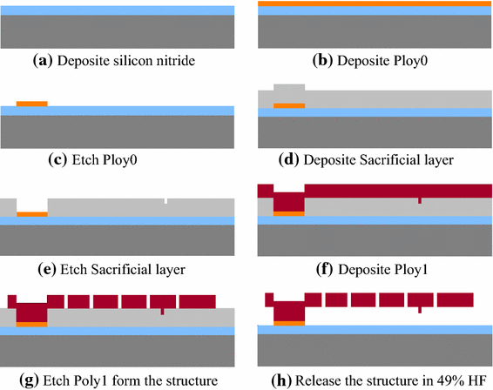
Fabrication of Two Hot-arm Micro Actuator

Slide 8
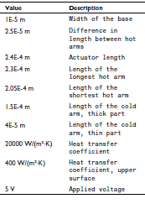
Parameter 2: Two-hot-arm thermal actuator

Slide 9
Simulation 2: Two-hot-arm thermal actuator

Slide 10
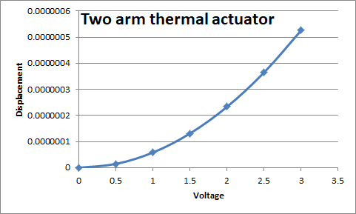
Results 2: Two-hot-arm thermal actuator

Slide 11
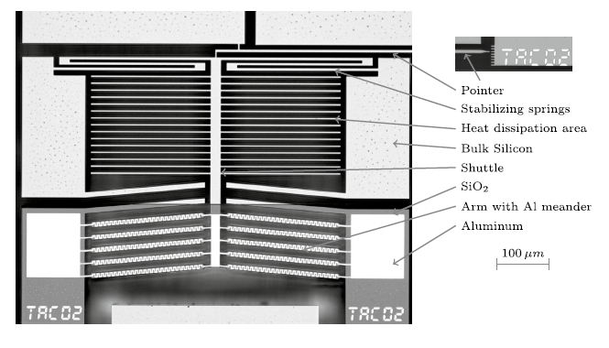
Design 3: In plane/Chevron/V shaped Thermal microactuator

Slide 12

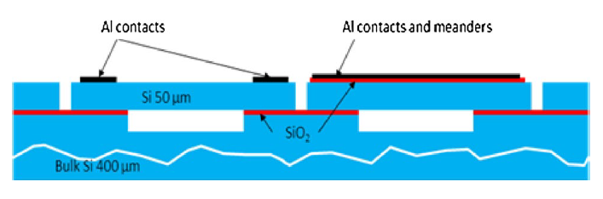
Fabrication of V-shaped Microactuator

Slide 13
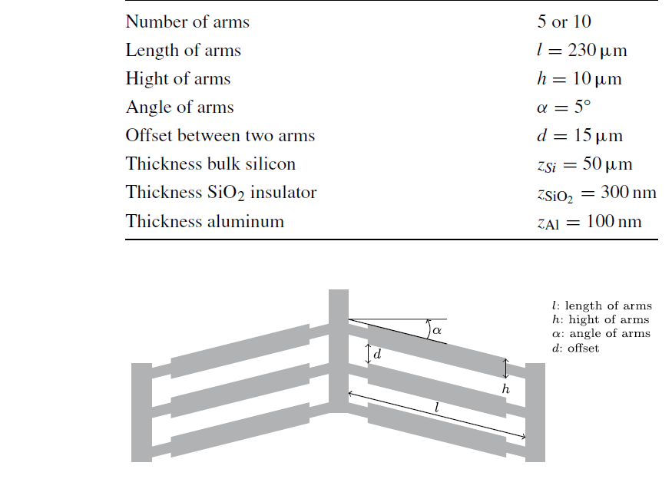
Parameter 3: In plane Thermal microactuator

Slide 14
Simulation 3: In plane Thermal microactuator

Slide 15
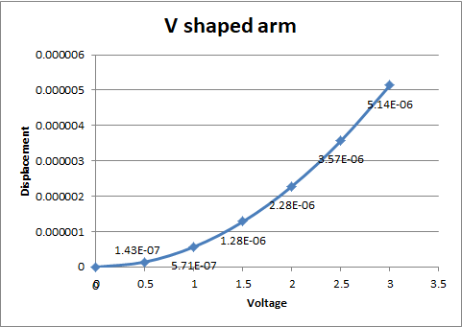
Results 3: In plane Thermal microactuator

Slide 16
Comparison of sensitivity values
One arm | 0.000667
Two arm | 2.05E-07
V shape | 2.00E-06

